Slide 1

Indoor Localisation with Sensor fusion of PDR and single RTT Wi-FI
Annie Marandi CS19M009
Sai Rohitth Chiluka ED18B027

Slide 2
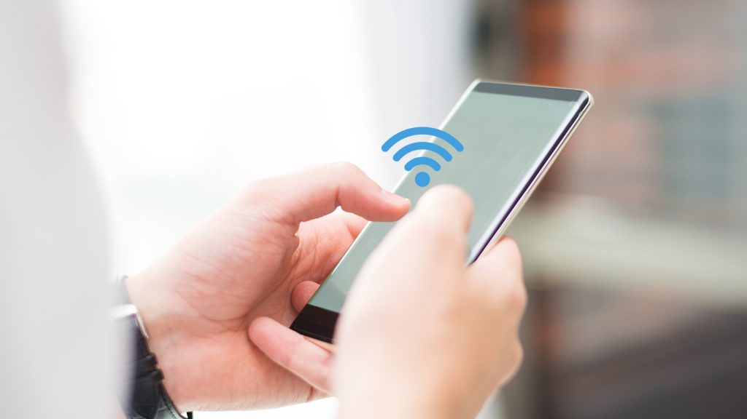
Problem definition
Indoor localization without using trilaterization.
We are only considering Single access point for Wi-Fi RTT.
Initial position is also known .
Position of AP is fixed.

Slide 3

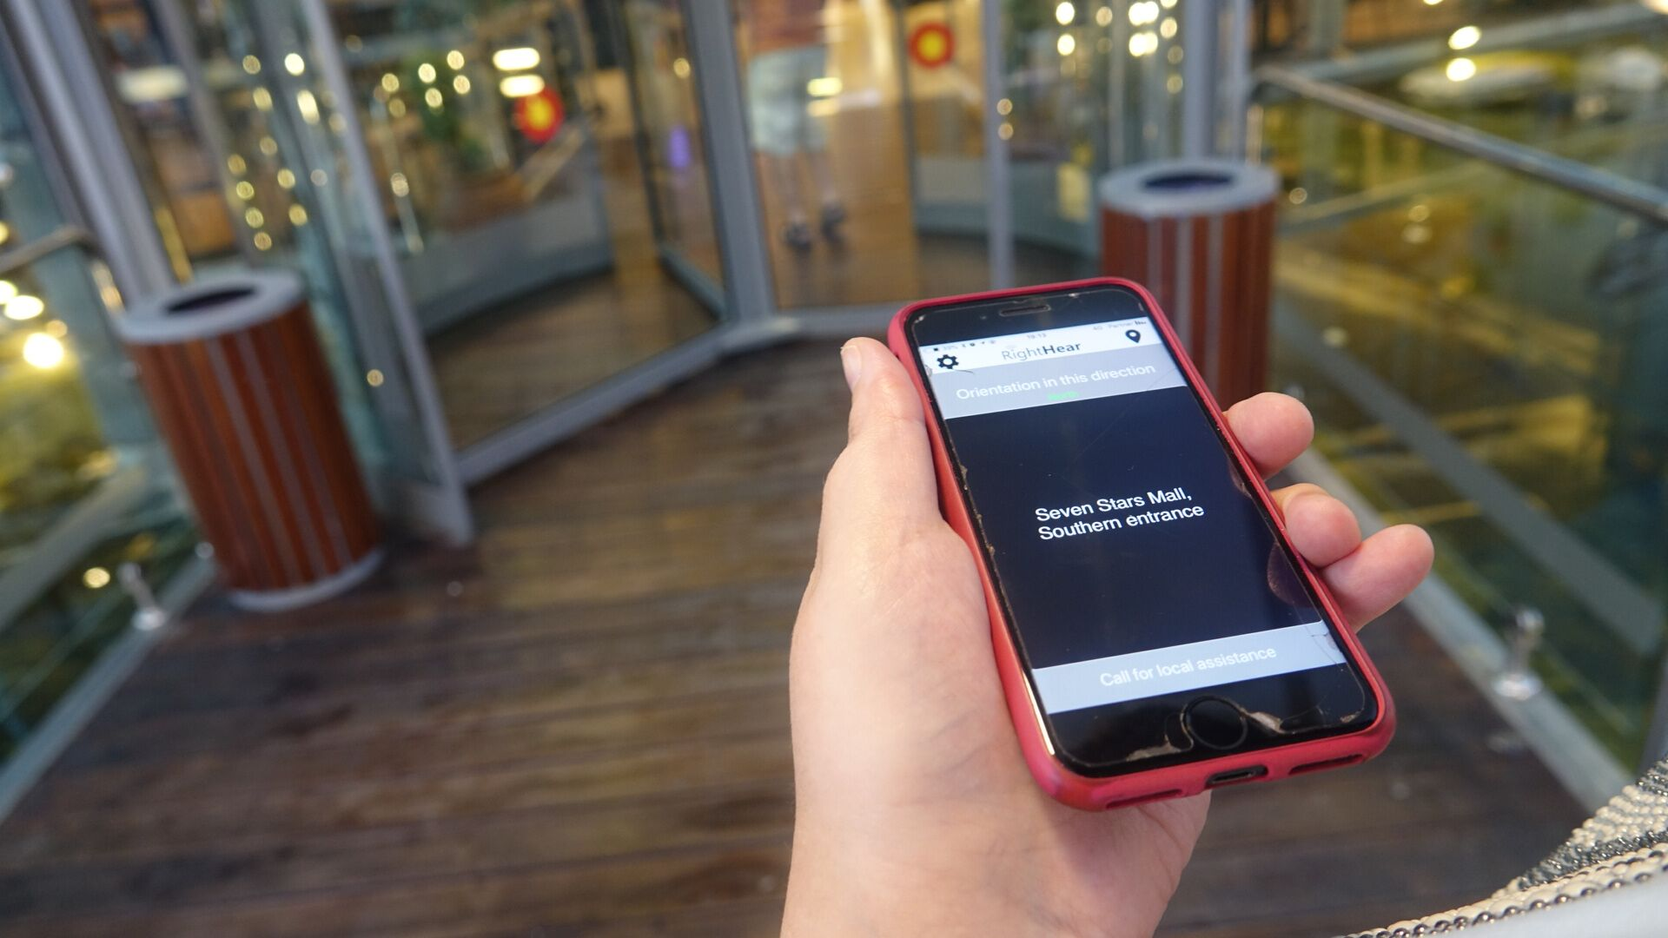
Application Examples
Supermarket Cart Location Analysis
Localization for the Visually Impaired in Public Places

Slide 4
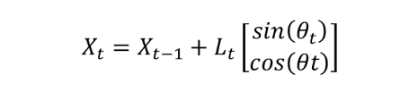
PDR
Getting IMU Data
Why we used PDR?
TYPE_LINEAR_ACCELERATION
Low-pass filter and high-pass filter
Double integration
Error accumulation
Where, L is the step length
and, 𝜃 is the heading w.r.t phone

Slide 5

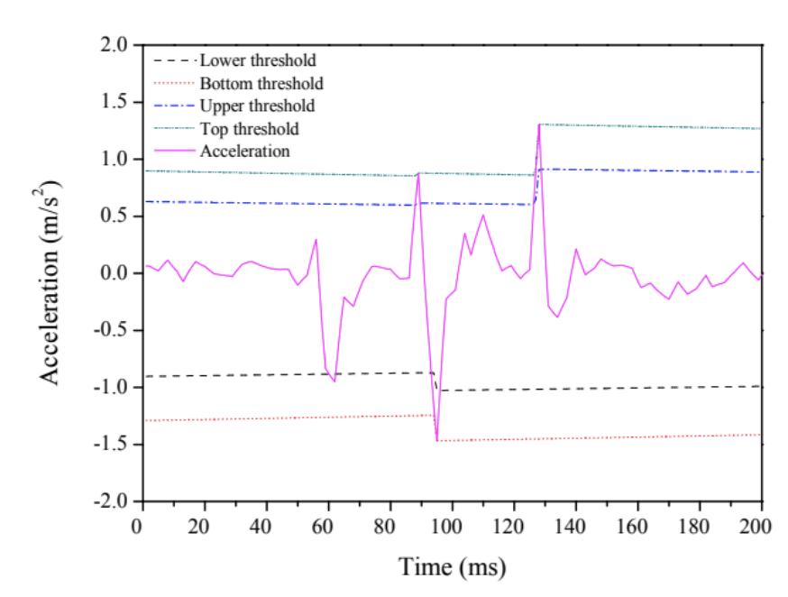
Step length
Step detect
Where, K = 0.68 - 0.37 * v + 0.15 *pow(v,2)
and, v is the average step velocity

Slide 6
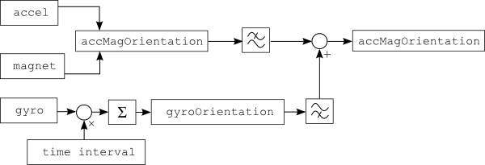
Sensor fusion using complementary filter

Slide 7
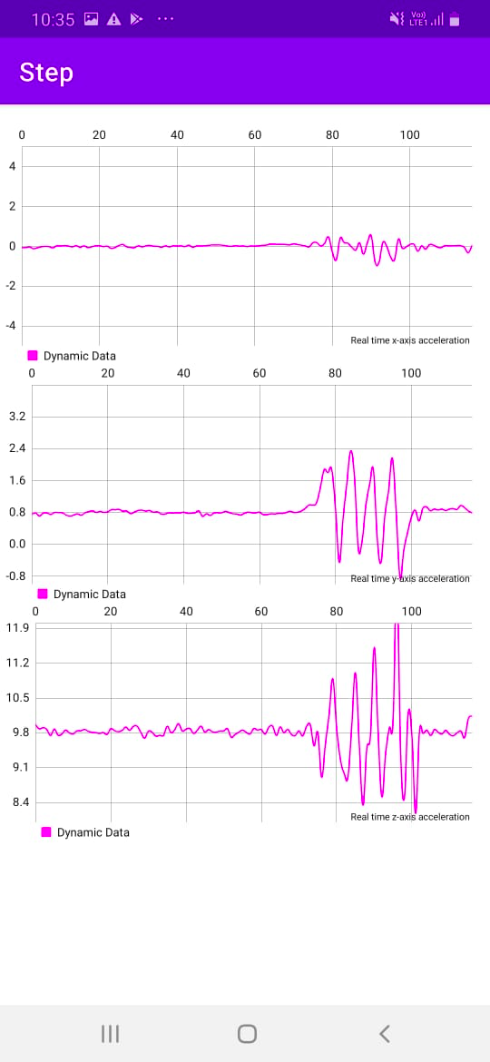
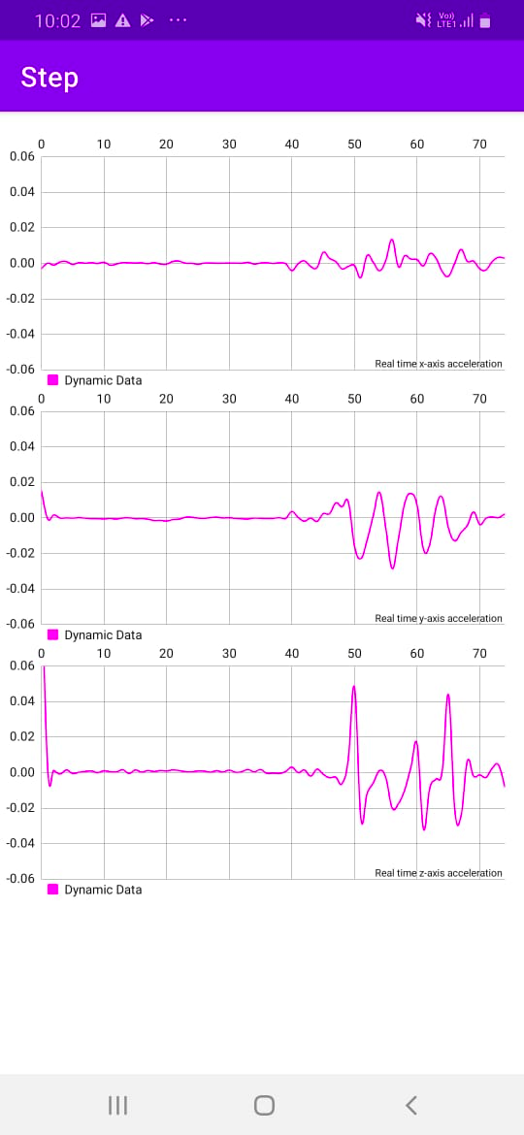
Acceleration
Raw acceleration readings
Acceleration remove gravity with LPF

Slide 8
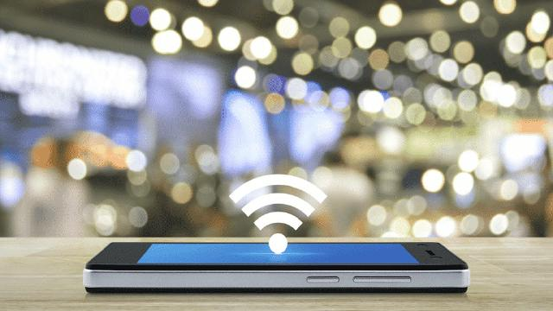
RTT range simulation
Gaussian noise added with mean 0 and std. Dev 0.5
Effect of Position of AP
Any point on perpendicular at the ends
On the circumference
Effect of Radius of circle
Bigger circle better
Effect of update frequency
updating less often better!

Slide 9
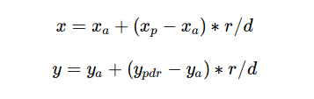
Single RTT Localization
Infinite solutions problem
Using PDR estimate position and find the closest point to this estimate:
Downside
Bad estimate if drift overpowers.

Slide 10
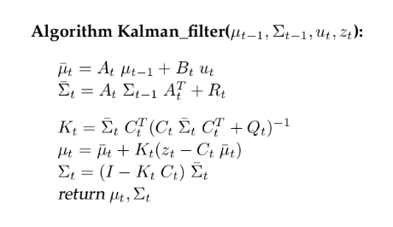
Kalman filter
Assumes all the noise is gaussian and all the models are linear.

Slide 11
Adjustment to make the model stay linear.
Achieving different update frequencies
Button
Downside
Measurement model may not be linear (EKF)

Slide 12
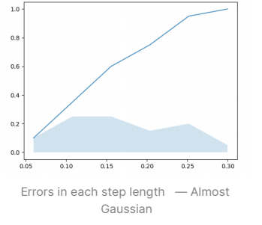
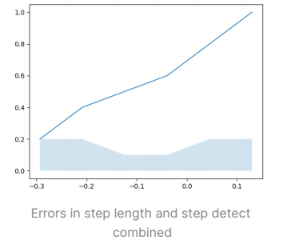
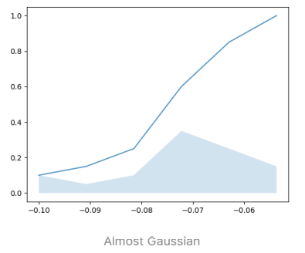
Bias variance estimation
Experiment procedure
Step length
Orientation
Downside

Slide 13
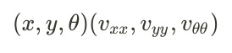
Walking simulation and post error analysis
For the line each step is taken to be 1m and and every 3m the RTT reading is also taken.
For the circle each step is taken as 1.73m, and a rotation of 20 degrees. Every 60 degrees the RTT is also taken into account.
Drift simulation
Sample output
Mean and max localization errors are calculated

Slide 14
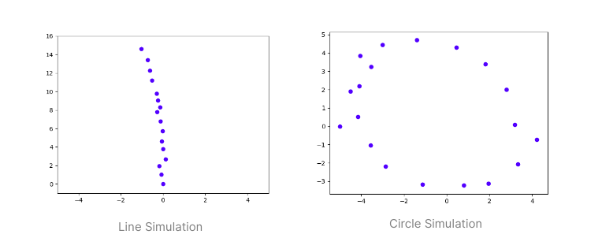

Slide 15
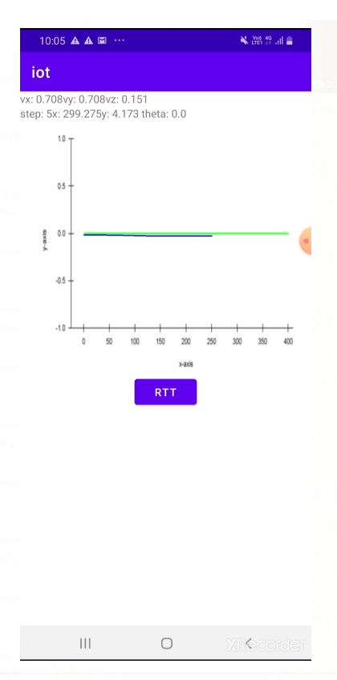
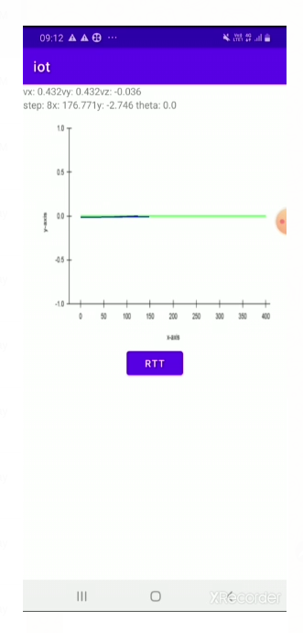
Android App
Without RTT
With RTT

Slide 16
Thank You!

